Slide 1
Eczema: An Overview
Prepared for Families of Rady Children’s Hospital

Slide 2
Definitions
Eczema/Atopic Dermatitis:
A red, itchy, flaky rash, sometimes oozing rash that can affect children and adults
When eczema is severe then it can affect a lot of the body and cause very bad itching
Severe eczema can make it hard to sleep and can interrupt normal activities

Slide 3
What causes eczema?
Eczema is complicated and we know that it is caused by more than just one thing. It is partially caused by genetics and partially caused by our surroundings.
Somethings make eczema worse, like…
Dry skin
Stress
Exposure to perfumes, fragrances, and harsh soaps

Slide 4
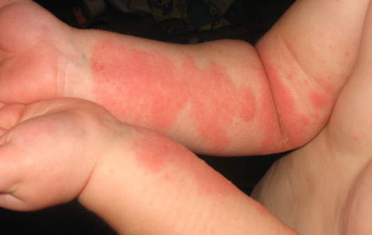
What’s with Eczema and Allergies?
Patients with eczema are more likely to have or develop food allergies, hay fever or asthma than patients without eczema

Slide 5
Principles of Eczema Treatment
Moisturizers
Anti-Itch Medications
Anti-Inflammation
Medications
Antibiotics

Slide 6
Bathing
We recommend that you bathe once every day or every other day
Always put a moisturizer on after bathing
Use gentle soaps
If you have medicine creams or ointments then you should put them on right after you bathe, before the moisturizer

Slide 7
Moisturizers
Not all moisturizers are as good at keeping skin hydrated
Generally, the thicker the moisturizer, the better it will work
Ointments are the best at keeping our skin hydrated
Try not to use moisturizers with smells or perfumes
Lotion | Cream | Ointment
Easy to rub in, but work the least at keeping the skin hydrated | Are between | Are the thickest and the best at keeping the skin hydrated

Slide 8
Sometimes we need medicated creams and ointments to treat eczema because moisturizers are not strong enough on their own to decrease the inflammation in the skin

Slide 9
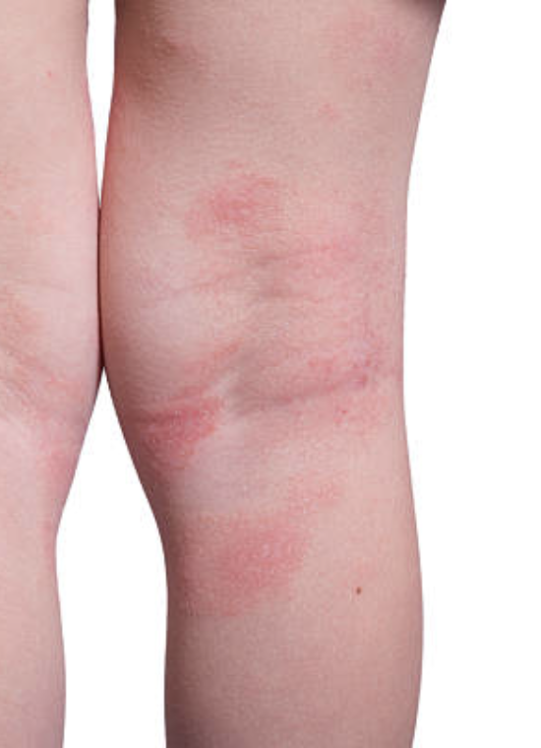
Topical Steroids
Topical steroids are a type of medicine cream or ointment.
You put topical steroids on top of the skin.
They are the standard way to treat for inflammation (when skin is red, bumpy, oozy or flaky)
Not all topical steroids are the same. Some topical steroids are very weak, but others are strong.
These medicines can be used safely when used according to your health care providerʹs instructions

Slide 10
Topical Steroid Safety
Your health care provider can tell you how to safely use topical steroids, and how much you should use over a period of time.
There are some rare side effects if steroids are used for too long. One side effect is thinning of the skin. This is very rare and only happens if you use certain medications continuously for weeks and weeks.
There are some parts of our skin that are more delicate, like the face, armpits, and groin. When we treat these areas, we will generally use less strong agents, for shorter periods of time, or only a few days a week.
Sometimes people hear that the topical steroids can slow growth. This can happen with steroids that are taken as a pill, but it is very very rare when we are using the medicine applied to our skin.
Really bad eczema can sometimes cause slow growth if we do not treat it.

Slide 11
How to Use Topical Steroids
Use one time every day or two times every day
Put it on all of the skin that is itchy, red, bumpy or flaky
You can ask your doctor how much medicine you should put on

Slide 12
Other Medications
There are some creams or ointment medications for eczema that do not have steroids in them, and can decrease inflammation
Examples include:
PDE4 inhibitors (Crisaborole)
Topical calcineurin inhibitors (Tacrolimus; Pimecrolimus)
These medicines may be used on delicate skin areas, like the face, groin, and armpits, or to treat inflamed eczema when we want to avoid topical steroids
These medicines are also used on skin that frequently would have eczema breakouts, applying it to to “keep away” the eczema

Slide 13
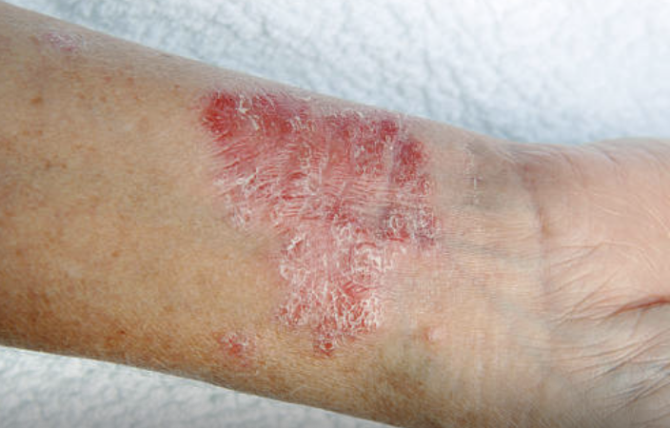
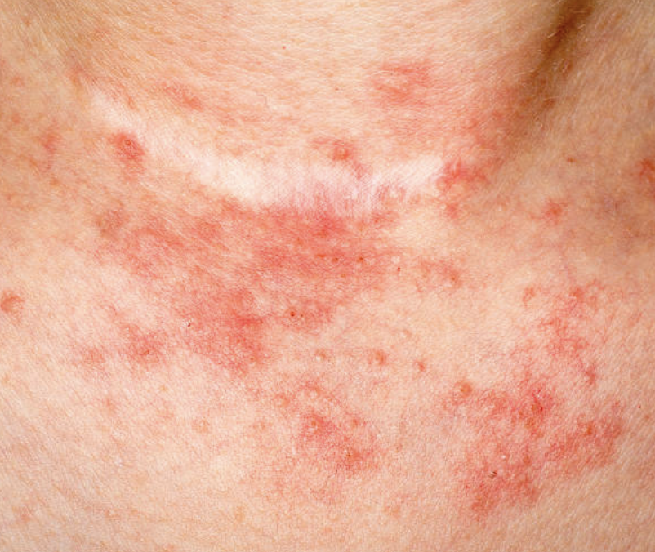
Systemic Therapy
Systemic medicines are ones you take as a pill or as an injection
These medicines are only used for patients who have more severe eczema and when creams or ointments aren’t working well enough to get or keep the skin clear
These medicines help patients have less eczema-- less rashes, less itching and keep the skin healthier
If you have questions about these medicines then you should ask your doctor

Slide 14
What about Antihistamines?
Antihistamines are sometimes used to minimize itching, or to help allergies, like hay fever.
Some antihistamines make people sleepy; these may sometimes help with sleep.
If you have allergies and eczema then this type of medicine might be helpful for you.

Slide 15
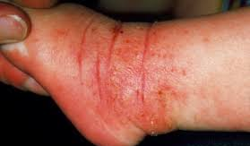
What About Antibiotics?
Sometimes skin with eczema can get infected by bacteria. Often it is from Staph bacteria.
If skin is infected then we may use antibiotics to treat the infection.
Antibiotics work differently than topical steroids, so you may have to use both at the same time.

Slide 16
Summary
The goal is to have minimal eczema rashes, very little itch, and sleep that isn’t disturbed by itching or scratching.
We work to this goal by using good skin care, avoiding triggers and using medicines as needed, or regularly, to minimize the eczema!
There are a lot of things we can do to treat your eczema, getting it under control, and keeping it under control.
Eczema is complicated. If you have questions then ask us questions.
You can read more about eczema at www.nationaleczema.org or searching “Rady” and “Eczema” (https://www.rchsd.org/programs-services/dermatology/eczema-and-inflammatory-skin-disease-center)

