Slide 1


COVID-19 Disease in Children
(as of March 27, 2020)
David W. Kimberlin, M.D.
University of Alabama at Birmingham

Slide 2
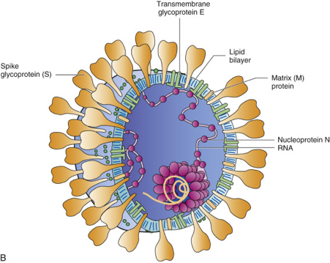
Coronaviruses
Enveloped +RNA virus named for solar
corona-like appearance of their virions
Second most prevalent cause of the
common cold
Replicate at lower temperatures, thus
predilection for upper respiratory tract
The corona helps the enveloped virus
survive the GI tract
Control of transmission is difficult

Slide 3
Human Endemic Coronaviruses (HCoVs)
229E, HKU1, NL63, OC43
Up to 15-30% of human colds
No durable immunity – frequent cycles of infection
Upper respiratory infections – most common
Lower respiratory infections – immunocompromised patients
Worldwide circulation
Winter and early spring
No vaccines or antivirals licensed or in use

Slide 4
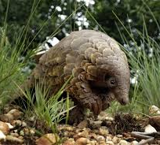
Emerging Coronaviruses
SARS-CoV (2002-2004) – Severe Acute Respiratory Syndrome
  > 8,000 cases, 10% mortality, 32 countries in 3 months
  Bats → Civet Cats / Raccoon Dogs → Humans
MERS-CoV
  > 2,500 cases, ~ 35% mortality, 27 countries
  Bats → Camels → Humans
SARS-CoV-2
  > 100,000 cases, 1-2% mortality, > 140 countries
  Bats → Pangolins??? → Humans

Slide 5
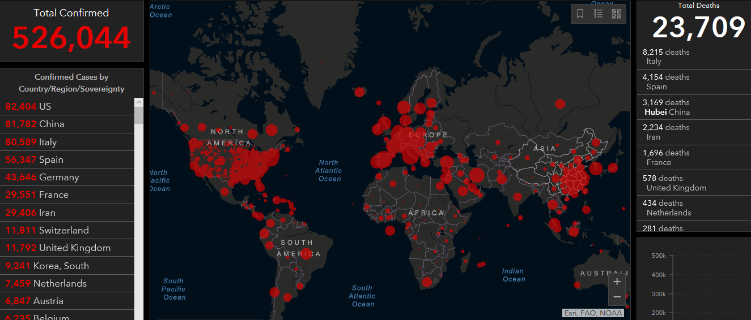
Johns Hopkins Coronavirus Map (as of 03/26/20)
https://coronavirus.jhu.edu/map.html

Slide 6
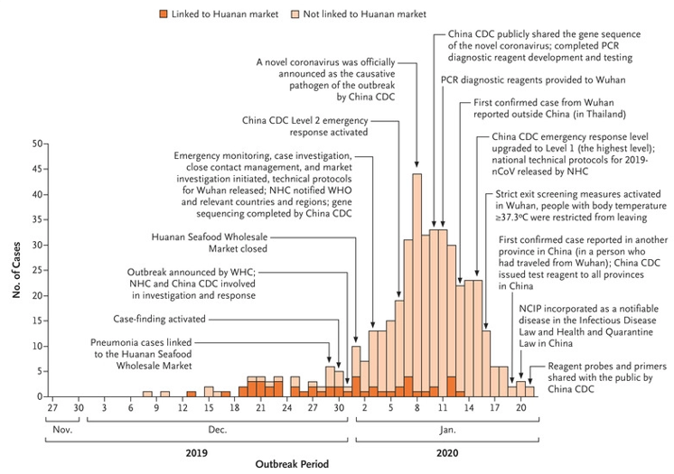
First 425 Confirmed Cases of SARS-CoV-2
Decline after January 8 likely due to delays in diagnosis and lab confirmation
Li et al, NEJM 2020, DOI: 10.1056/NEJMoa2001316
January 29, 2020

Slide 7
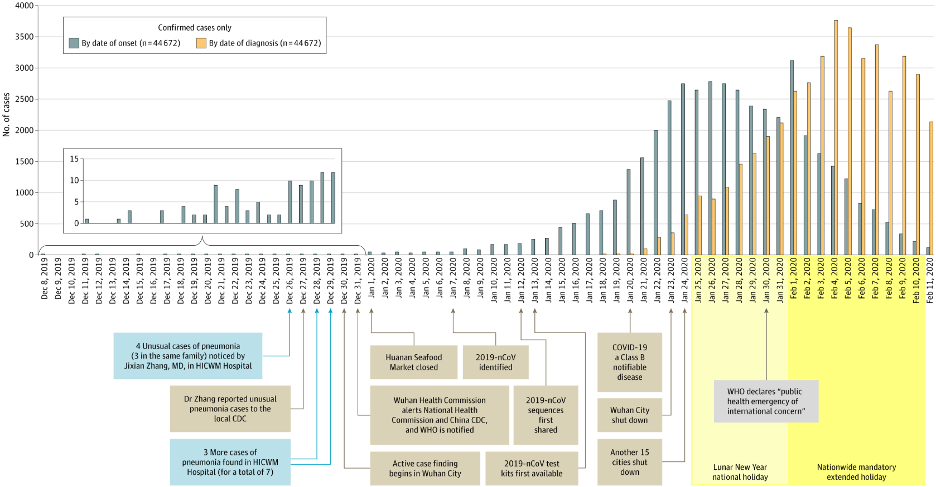
72,314 Cases Reported by Chinese CDC
Wu and McGoogan
JAMA. Published online February 24, 2020. doi:10.1001/jama.2020.2648

Slide 8
COVID-19 Clinical Symptoms
Fever (83-98%)
Cough (46-82%)
Myalgia or fatigue (11-44%)
Shortness of breath (31%)
Less common symptoms: diarrhea, productive sputum
Potential for worsening clinical course during second week of symptoms
ARDS developed in 17-29% of hospitalized patients
Secondary infection in 10% of hospitalized patients
Chen et al., Lancet 2020
Huang et al., Lancet 2020

Slide 9
COVID-19 Disease Severity
36,160 cases (81%) reported mild symptoms
6,168 cases (13.8%) reported severe symptoms
2,087 cases (4.7%) critically ill
Case fatality higher among those with comorbid conditions (2-12%) compared with those with no comorbid conditions (0.9%)
China CDC Weekly Report February 17, 2020

Slide 10
Age of Confirmed Cases in China, 02/11/20
 | Cases N (%)
0-9 years | 416 (0.9)
10-19 years | 549 (1.2)
20-29 years | 3,619 (8.1)
30-39 years | 7,600 (17.0)
40-49 years | 8,571 (19.2)
50-59 years | 10,008 (22.4)
60-69 years | 8,583 (19.2)
70-79 years | 3,918 (8.8)
≥ 80 years | 1,408 (3.2)
China CDC Weekly Report February 17, 2020

Slide 11
Mortality of Confirmed Cases in China 02/11/20
 | Cases N (%) | Deaths N (%) | Case Fatality Rate (%)
Overall | 44,672 | 1,023 | 2.3%
0-9 years | 416 (0.9)
10-19 years | 549 (1.2) | 1 (0.1) | 0.2
20-29 years | 3,619 (8.1) | 7 (0.7) | 0.2
30-39 years | 7,600 (17.0) | 18 (1.8) | 0.2
40-49 years | 8,571 (19.2) | 38 (3.7) | 0.4
50-59 years | 10,008 (22.4) | 130 (12.7) | 1.3
60-69 years | 8,583 (19.2) | 309 (30.2) | 3.6
70-79 years | 3,918 (8.8) | 312 (30.5) | 8.0
≥ 80 years | 1,408 (3.2) | 208 (20.3) | 14.8
China CDC Weekly Report February 17, 2020

Slide 12
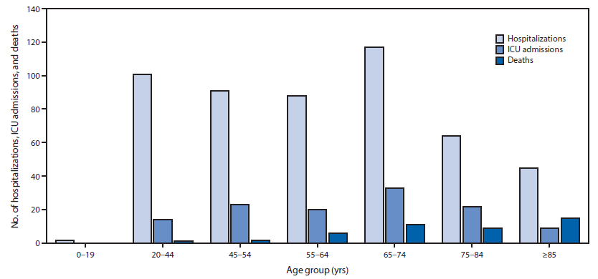
Hospitalizations, ICU Admissions, Deaths
United States, February 12 – March 16
MMWR, Vol. 69 Early Release, March 18
https://www.cdc.gov/mmwr/volumes/69/wr/pdfs/mm6912e2-H.pdf

Slide 13
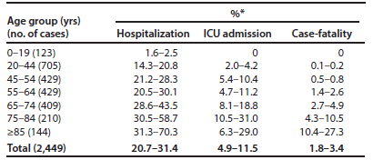
Hospitalizations, ICU Admissions, Deaths
United States, February 12 – March 16
MMWR, Vol. 69 Early Release, March 18
https://www.cdc.gov/mmwr/volumes/69/wr/pdfs/mm6912e2-H.pdf

Slide 14
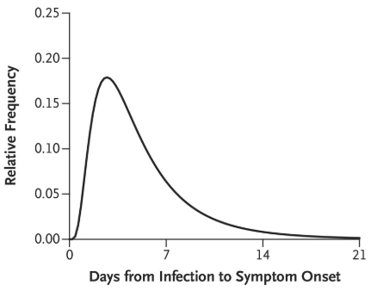
Incubation Time
Li et al, NEJM 2020, DOI: 10.1056/NEJMoa2001316

Slide 15
Reproductive Number (R₀)
The rate of spread of an epidemic, and whether such spread is self sustaining, depends on the magnitude of the basic reproduction number
The average number of secondary cases generated by one primary case in a susceptible population.

Slide 16
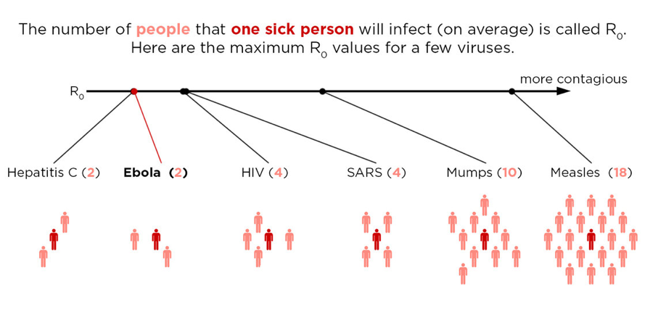

Slide 17
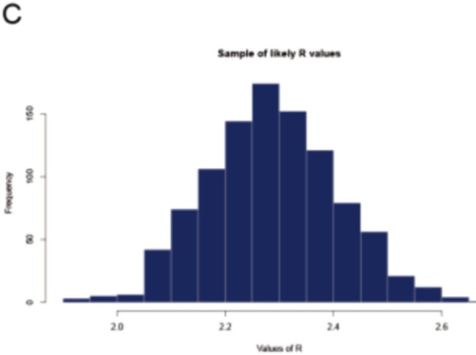
R₀ From Diamond Princess Cruise Ship
R₀: 2.28
(95% CI: 2.06, 2.52)
Zhang et al,
Int J Infect Dis. 2020 Feb22; 93:201-204. doi: 10.1016/j.ijid.2020.02.033

Slide 18
Proportion of Infected Patients Who Remain Asymptomatic Throughout Infection
Diamond Princess cruise ship
3,711 passengers, of whom 634 had confirmed SARS-CoV-2 infection
Findings:
  Assumption: Delay between infection and onset of symptomatic infection is a mean of 6.4 days (SD 2.3 days)
  Estimated asymptomatic proportion (among all infected cases) = 17.9% (95% CI: 15.5–20.2%)
Sensitivity analysis:
  Adjusting mean incubation period to between 5.5 and 9.5 days
  Estimated asymptomatic proportion ranges from 20.6% (95% CI: 18.5–22.8%) to 39.9% (95% CI: 35.7–44.1%)
Mizumoto et al., Euro Surveill. 2020;25(10):pii=2000180. https://doi.org/10.2807/1560-7917.ES.2020.25.10.2000180

Slide 19
Proportion of Infected Patients Who Remain Asymptomatic Throughout Infection
565 Japanese nationals evacuated by plane from Wuhan, China
All tested by PCR for SARS-CoV-2
Followed for 14 days for onset of symptoms
12 tested positive by PCR
  41.6% (95% CI: 16.7%, 66.7%) remained asymptomatic throughout 14 days
  IF one of the five asymptomatics develop symptoms beyond the 14 days of follow-up, this changes to 33.3% (95% CI: 8.3%, 58.3%)
Nishiura et al., medRxiv. 17 Feb 2020. www.eurosurveillance.org 5
https://doi.org/http://dx.doi.org/10.1101/2020.02.03.20020248

Slide 20
Proportion of Infected Patients Who Remain Asymptomatic Throughout Infection
Mathematical modeling simulating spatiotemporal dynamics of infections among 375 Chinese cities
Before widespread limitation on movement:
  Undocumented infections (as proportion of all infections): 86.2% (95% CI: 81.6%–89.8%)
  “These undocumented infections were 55% as contagious as documented infections”
  R₀ = 2.38 (95% CI: 2.04, 2.77)
After widespread limitation on movement:
  Undocumented infections (as proportion of all infections): 35%
  “The contagiousness of undocumented infections…was substantially reduced, possibly reflecting that only very mild, less contagious infections remain undocumented or that individual protective behavior and contact precautions have proven effective.”
  R₀ = 0.99 (95% CI: 0.76–1.33)
Li et al., Science 10.1126/science.abb3221 (2020)

Slide 21
2,143 Pediatric COVID-19 Cases in China
Dong et al., Pediatrics. 2020; doi: 10.1542/peds.2020-0702; Advance Released March 16, 2020
Asymptomatic infection: No clinical symptoms and signs and the chest imaging is normal, but the SARS-CoV-2 PCR is positive.
Mild: Acute upper respiratory tract symptoms, including fever, fatigue, myalgia, cough, sore throat, runny nose, and sneezing. Physical examination shows congestion of the pharynx and no auscultory abnormalities. Some cases may have no fever, or have only digestive symptoms such as nausea, vomiting, abdominal pain and diarrhea.
Moderate: Pneumonia, frequent fever and cough (mostly dry, then productive), some may have wheezing, but no obvious hypoxemia such as shortness of breath, and lungs with rhonchi. Some cases may have no clinical signs and symptoms, but chest CT shows lung lesions.
Severe: Early respiratory symptoms such as fever and cough, may be accompanied by gastrointestinal symptoms such as diarrhea. The disease usually progresses around 1 week, and dyspnea occurs, with central cyanosis. Oxygen saturation is less than 92%, with other hypoxia manifestations.
Critical: Rapid progression to acute respiratory distress syndrome (ARDS) or respiratory failure, with or without shock, encephalopathy, myocardial injury or heart failure, coagulation dysfunction, and acute kidney injury. Organ dysfunction can be life threatening.

Slide 22
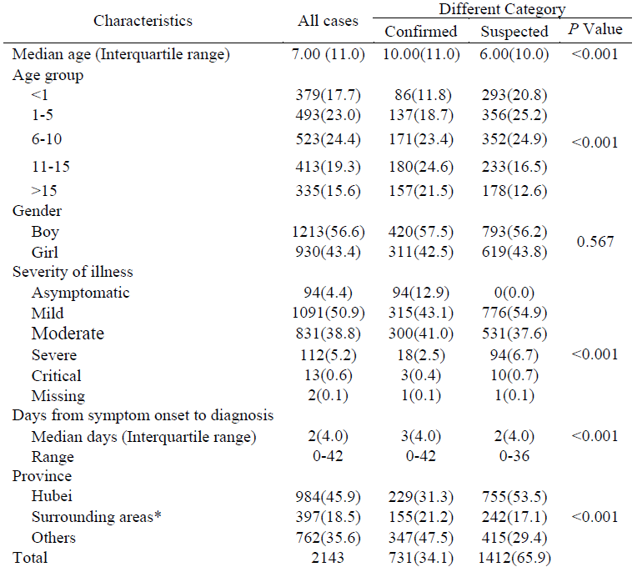
2,143 Pediatric COVID-19 Cases in China
Dong et al., Pediatrics. 2020; doi: 10.1542/peds.2020-0702; Advance Released March 16, 2020

Slide 23
2,143 Pediatric COVID-19 Cases in China
Dong et al., Pediatrics. 2020; doi: 10.1542/peds.2020-0702; Advance Released March 16, 2020

Slide 24
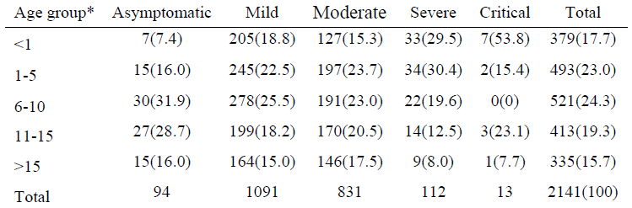
2,143 Pediatric COVID-19 Cases in China
Dong et al., Pediatrics. 2020; doi: 10.1542/peds.2020-0702; Advance Released March 16, 2020

Slide 25
2,143 Pediatric COVID-19 Cases in China
Dong et al., Pediatrics. 2020; doi: 10.1542/peds.2020-0702; Advance Released March 16, 2020

Slide 26
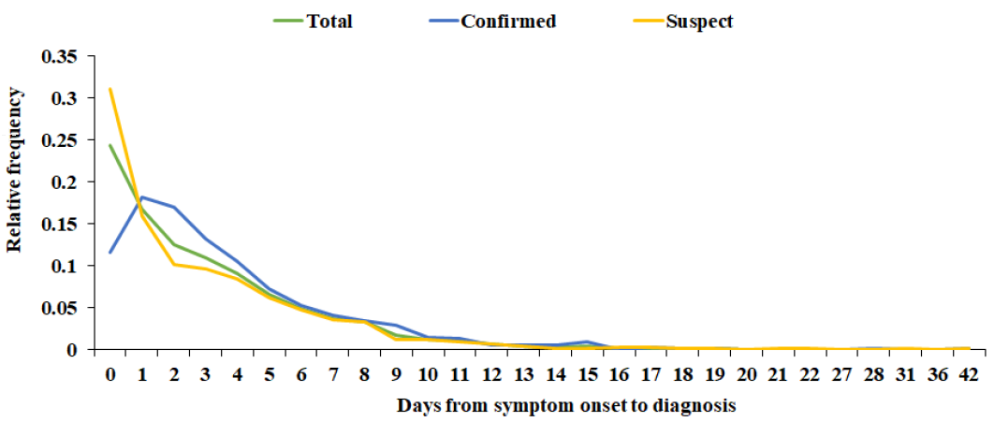
2,143 Pediatric COVID-19 Cases in China
Dong et al., Pediatrics. 2020; doi: 10.1542/peds.2020-0702; Advance Released March 16, 2020

Slide 27
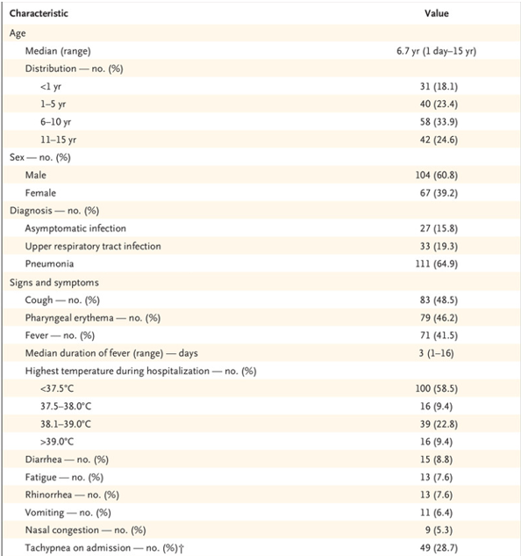
171 Pediatric COVID-19 Cases in Wuhan
Lu et al., N Engl J Med. DOI: 10.1056/NEJMc2005073; Advance Released March 18, 2020

Slide 28
171 Pediatric COVID-19 Cases in Wuhan
Lu et al., N Engl J Med. DOI: 10.1056/NEJMc2005073; Advance Released March 18, 2020

Slide 29
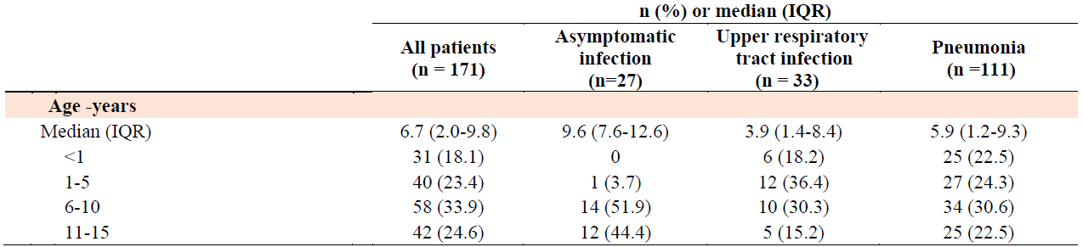
171 Pediatric COVID-19 Cases in Wuhan
Lu et al., N Engl J Med. DOI: 10.1056/NEJMc2005073; Advance Released March 18, 2020

Slide 30
171 Pediatric COVID-19 Cases in Wuhan
Lu et al., N Engl J Med. DOI: 10.1056/NEJMc2005073; Advance Released March 18, 2020

Slide 31
SARS-CoV-2 Transmission
Based on knowledge of other coronaviruses (including SARS and MERS)
Person to person via respiratory droplets among close contacts
  Within 6 feet of a patient with SARS-CoV-2 for a prolonged period of time
  Having direct contact with infectious secretions from a patient with SARS-CoV-2 (sputum, serum, blood, respiratory droplets)
  SARS-CoV-2 has been detected in stool, but clinical significance is unknown
https://www.cdc.gov/coronavirus/2019-ncov/hcp/faq.html

Slide 32
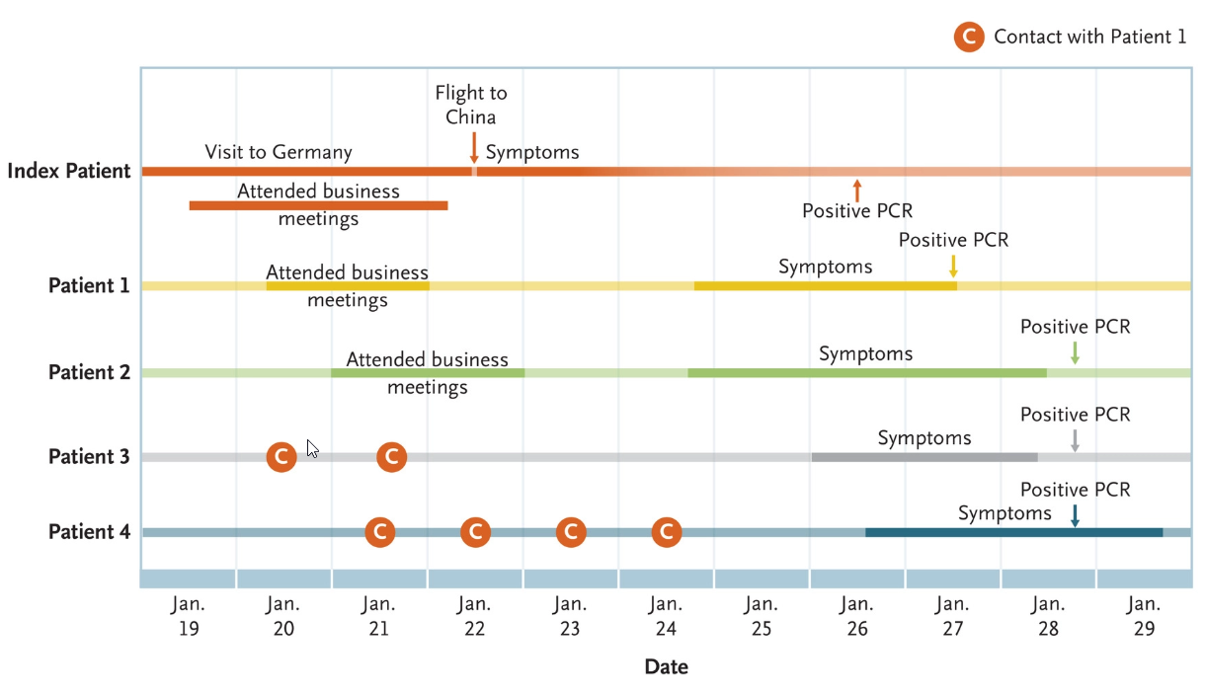
Asymptomatic Transmission of SARS-CoV-2
Rothe et al., N Engl J Med 2020; 382:970-971

Slide 33
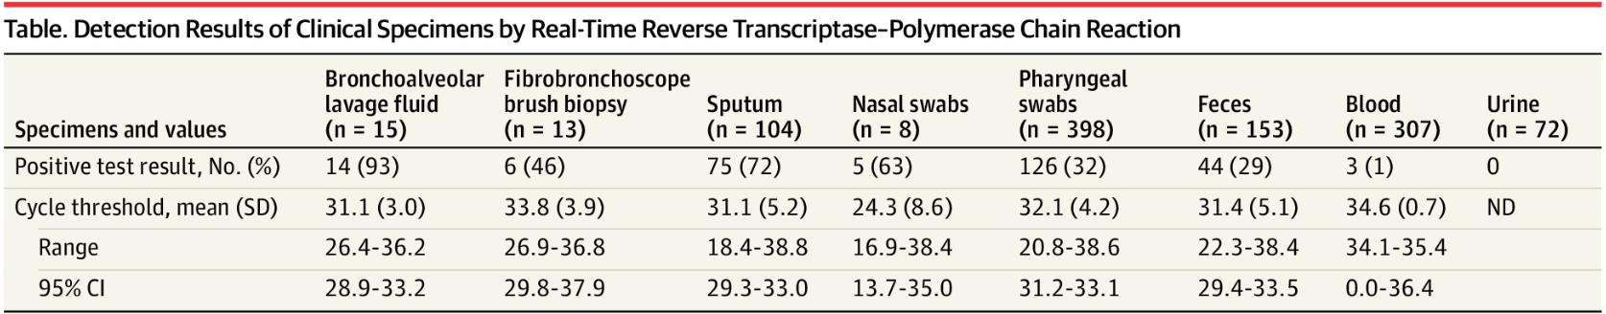
PCR Detection of SARS-CoV-2
1070 Specimens from 205 Patients (5-67 yrs)
Wang et al., JAMA. Published online March 11, 2020. doi:10.1001/jama.2020.3786

Slide 34
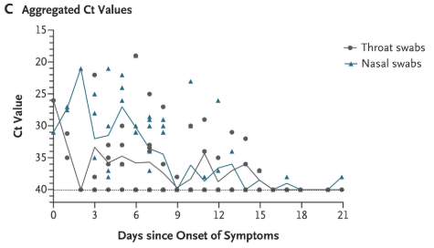
PCR Detection of SARS-CoV-2
144 Specimens from 18 Patients (26-76 yrs)
“The viral load that was detected in the asymptomatic patient was similar to that in the symptomatic patients”
Zou et al, NEJM
February 19, 2020
DOI: 10.1056/NEJMc2001737

Slide 35
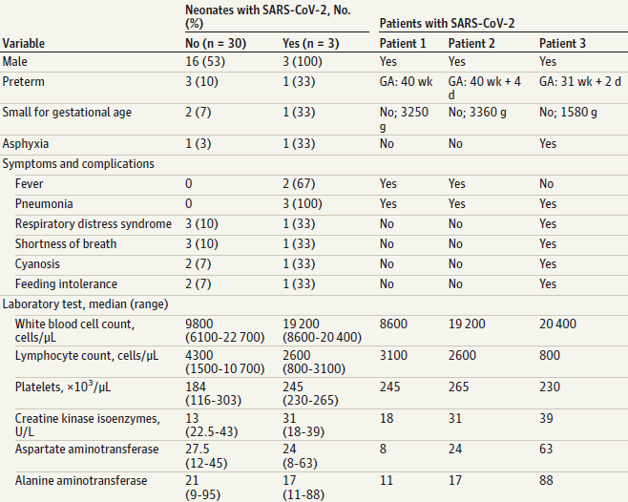
(Likely) Perinatal Transmission
Zeng L, et al., JAMA Pediatrics, Advanced Release March 26, 2020. doi:10.1001/jamapediatrics.2020.0878

Slide 36
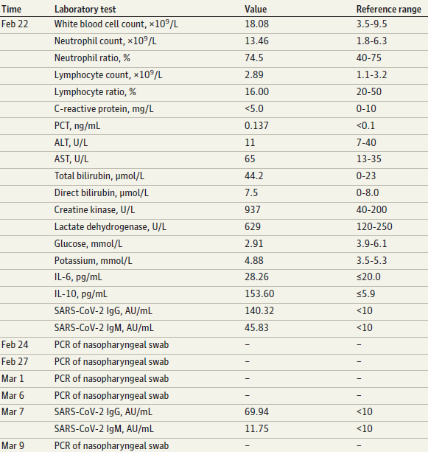
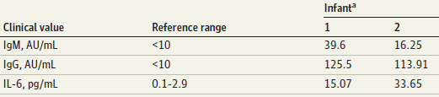
(Potential) Congenital Transmission
Kimberlin and Stagno, Advance Release March 26, 2020.
doi:10.1001/jama.2020.4868
Dong et al., JAMA, Advance Release March 26, 2020. doi:10.1001/jama.2020.4621
Zeng H, et al., JAMA, Advance Release March 26, 2020. doi:10.1001/jama.2020.4861

Slide 37
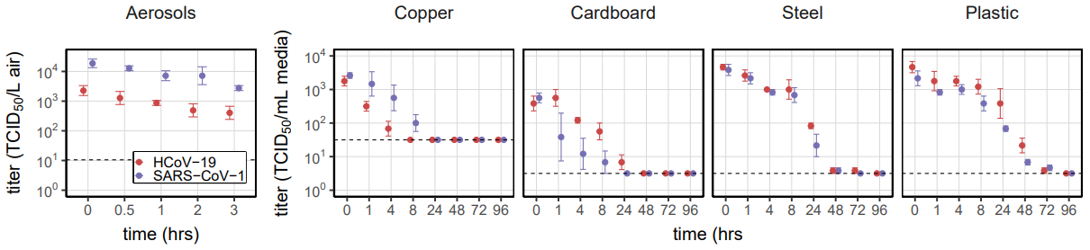
SARS-CoV-2 Stability in Environment
https://www.medrxiv.org/content/10.1101/2020.03.09.20033217v2.full.pdf
Van Doremalen et al, doi: https://doi.org/10.1101/2020.03.09.20033217

Slide 38
SARS-CoV-2 Stability in Environment
 | SARS-CoV-2
 | Half-life (hours)
Material | Median | 2.5% | 97.5%
Aerosols | 2.74 | 1.65 | 7.24
Copper | 3.4 | 2.4 | 5.11
Cardboard | 8.45 | 5.95 | 12.4
Steel | 13.1 | 10.5 | 16.1
Plastic | 15.9 | 13 | 19.2
https://www.medrxiv.org/content/10.1101/2020.03.09.20033217v2.full.pdf
Van Doremalen et al, doi: https://doi.org/10.1101/2020.03.09.20033217

Slide 39
COVID-19 Treatment in Pediatric Patients
Supportive care
No current RCT data to recommend any specific antiviral or immunomodulatory treatment

Slide 40
COVID-19 Treatment in Pediatric Patients
Remdesivir
  Nucleotide prodrug, inhibits RNA-dependent RNA polymerase and permanently terminates viral RNA transcription
  Available through clinical trials (Gilead, NIH), expanded access (nonpregnant adults), compassionate use (children, pregnant women)
Chloroquine/Hydroxychloroquine
  Heme polymerase inhibitor, increases pH of phagolysosome interrupting virus/cell fusion, interferes with glycosylation of cellular receptors of SARS-CoV-2
  Small (n=36) open-label nonrandomized study reported benefit (Gautrel et al, 2020)
  No benefit in small (n=30) RCT (Chen et al., DOI : 10.3785/j.issn.1008-9292.2020.03.03)
Lopinavir/Ritonavir
  HIV protease inhibitor
  No benefit in large (n=199) RCT (Cao, 2020)

Slide 41
Conclusions
Children are less severely impacted by SARS-CoV-2 than adults
Infants and children with chronic conditions may be at more risk
The peak of the wave of COVID-19 disease has not reached us yet
Between 20% and 40% of all infected persons (and 15% of children) remain asymptomatic throughout the entire course of infection
Dramatic measures to decrease movement and socialization can decrease viral spread very significantly
Environmental contamination is an important risk for transmission, along with close personal contact
Treatment is supportive care

Slide 42

Deciding How to Respond
Step 1: Identify the technique
Conspiracy
Step 2: Identify the topic
Trust
Step 3: Respond with key message
Unmask the technique used
Fake Experts
Selectivity
Impossible expectations
Misrepresentation/False logic
Threat of disease
Effectiveness
Safety
Alternatives
Use key messages that relate to the topic raised

